Slide 1

Chicago Food Inspections
Autumn 2020
CDGL Group

Slide 2

Executive Summary
In the modern world, consumers are more empowered than ever. They increasingly use freely-available tools on the internet to make informed decisions while relying less upon traditional trust-building sources such as word-of-mouth. While internet sources such as Yelp can provide valuable information, there remains significant opportunity to enhance the quality of data readily available to consumers.
To further empower consumers in the City of Chicago, CDGL Group plans to extract, analyze and data collected by the Chicago Department of Public Health Food Protection Program. These results will underpin a set of tools to improve customer access to the following information:
Restaurant and other food establishment recommendations
Cleanliness score (this score aggregates the results of restaurant inspections)
Locations with clean restaurants

Slide 3
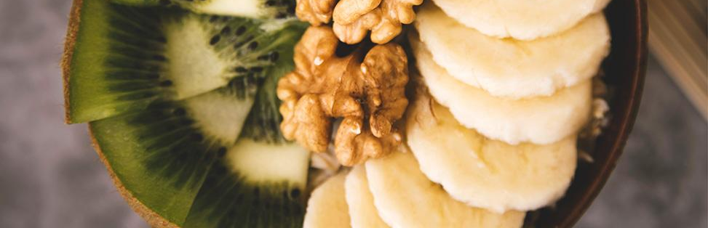
Business Use Case
CDGL Group plans to deliver Phase 1 Delivery of a MVP (Minimal Viable Product) designed to make it easier for customers to access food establishment cleanliness data in the City of Chicago, sourced from data collected by the Chicago Department of Public Health.
The proposed tools could serve as the front-end of a platform designed to collect data about where people eat.
Enriching the platform
Growing the user base over time
Generate revenue through ads or selling predictive user data

Slide 4
Data Profile And Tools
Data
Structured Dataset
Tools
Data available via API from City of Chicago
- 213606 rows (as of Dec 7 2020)
- 18 attributes: Inspection ID (Int), 15 string columns, and 3 float columns
- Python for data cleaning and ETL
- Tableau for data visualization
- GCP Compute for shell scripting
- GCP MySQL for schema and storage

Slide 5
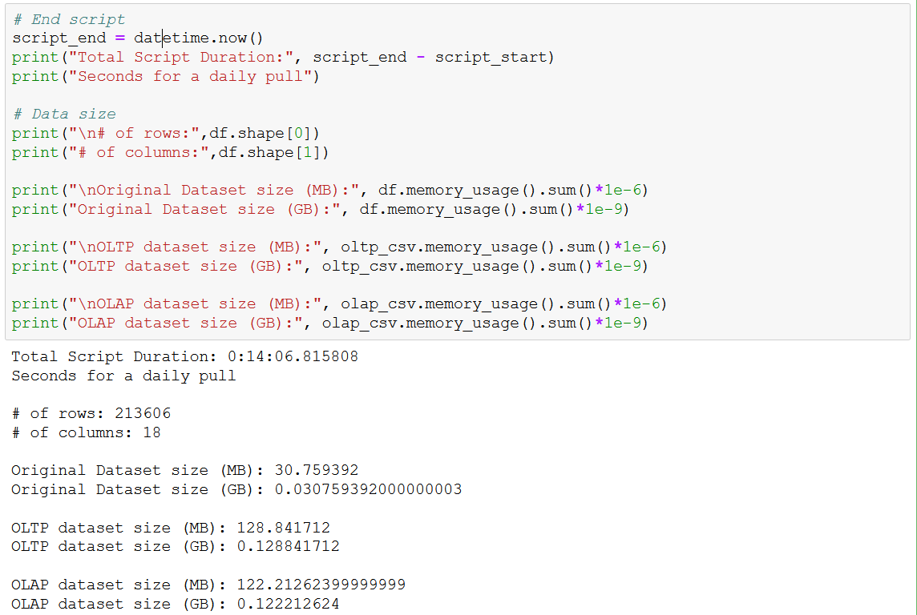
Data Profile Template

Slide 6
Data Quality
Timeliness
Our product pulls up to date inspection data directly from the City of Chicago’s latest food inspections.
Accuracy / Consistency
We ensured that all restaurants are rated in the same way, regardless of how many inspections or how many previous violations that they had.
Completeness
We’re ingesting 100% of all data available from the source.

Slide 7
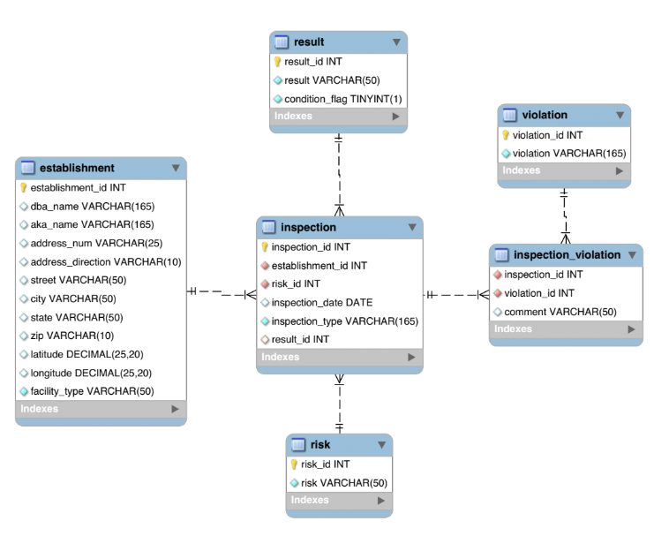
Design Considerations and EER
Resources provided would be used by many different audiences, including locals, tourists, journalists, and even local officials
Basic descriptive statistics should be readily available to end users
Data should be refreshed at a cycle corresponding with the update of the raw data (weekly per Chicago DPH)
Any derived features not covered by Chicago DPH should have referenceable definitions including calculation formulas where applicable

Slide 8
Platform Considerations
DBMS | PROS (+) | CONS (-)
MongoDB | Easy to directly ingest JSON response using Data Portal’s API Flexible data model will scale easily with emergence of net new data elements | Difficult to parse JSON to create arrays to easily query multiple violations and comments Lack of controls to prevent duplication of data
Neo4j | Able to create informational nodes for each inspection | Inspection data does not translate well to graphical visualization
MySQL | GCP-supported Python transformations on tabular data with pandas and numpy to insert to OLTP and OLAP schemas | Changes to data pipeline are required to support net new data elements. Fields have been static since data’s inception in 2010

Slide 9
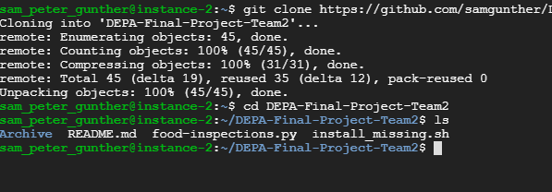
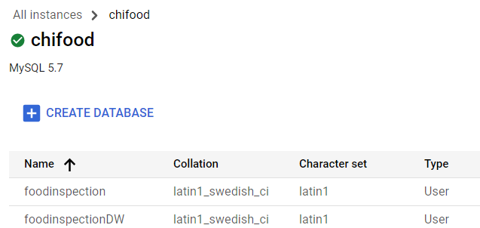
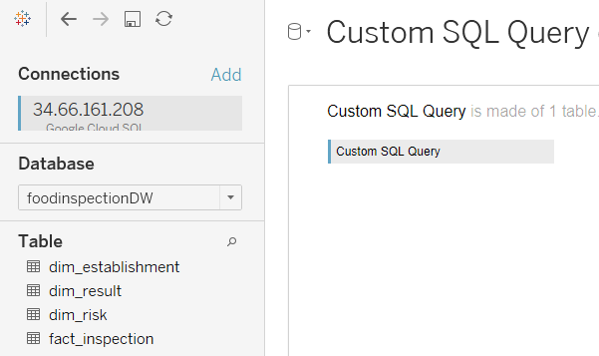
Platform Design
Our data pipeline infrastructure is managed in Google Cloud and our code lives in GitHub to enable scalable end-user deployment and ETL maintenance
Extract/Prepare
Store/Organize
Analyze/Process
Chicago DPH API
Python (GitHub repo)
OLAP Database (GCP MySQL
Visualize/Explore
End User Dashboard
Tableau
OLTP Snowflake (GCP MySQL

Slide 10
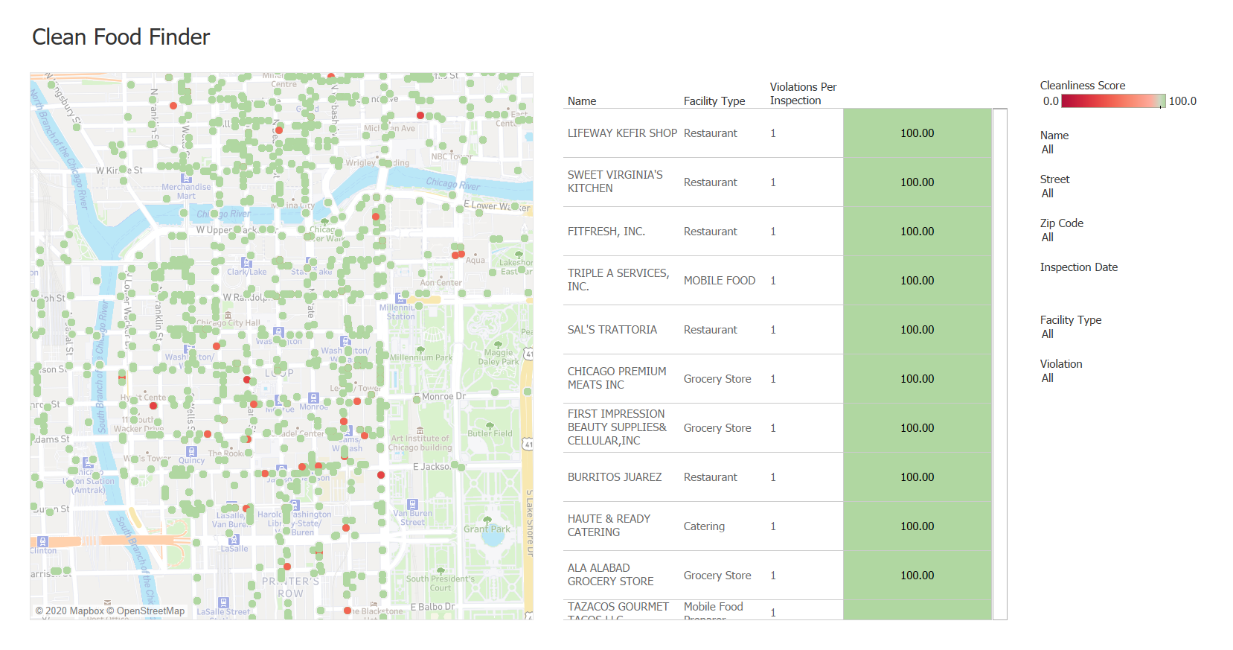
Dashboard Demo

Slide 11
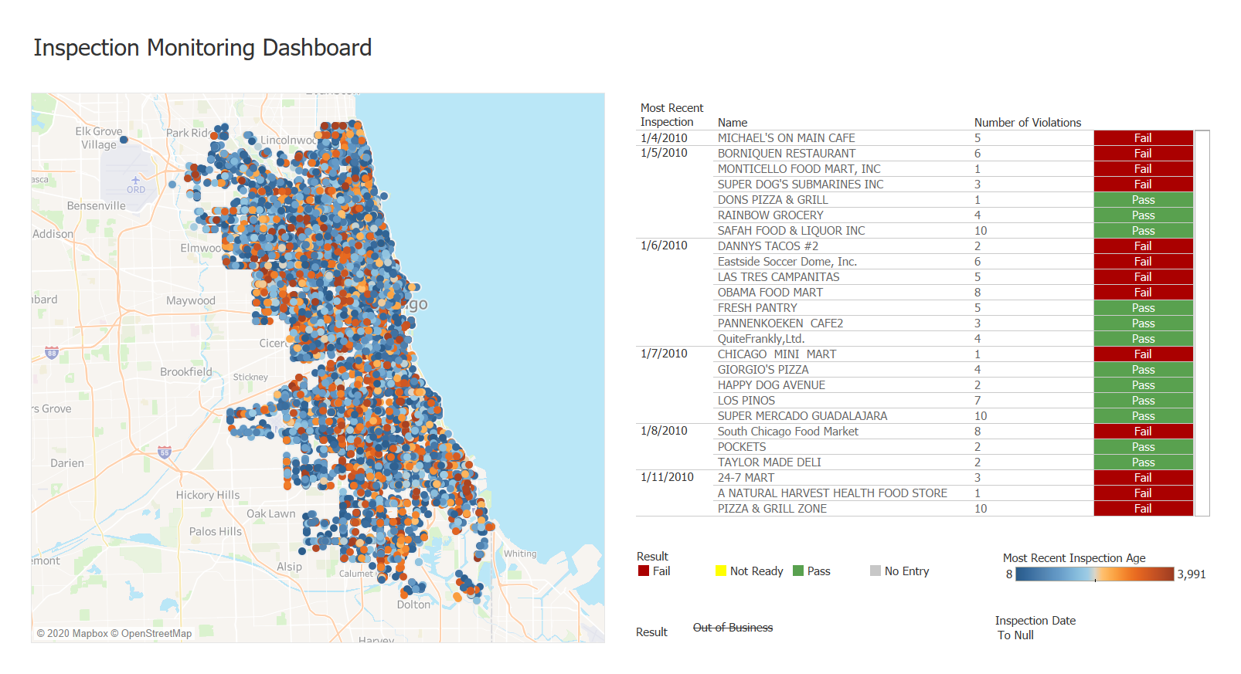
Dashboard Demo

Slide 12
Next Steps
Phase 2
Phase 3
Phase 4
Phase 5
Infrastructure
Enhance Dashboard
Expand Use Case
Enrich Data Set
Operationalize the pipeline in GCP for end user availability
Enable drill through in dashboards
Develop additional metrics and end user capabilities
Add supplementary data sources to enhance user functionality

Slide 13
Lessons Learned
Work Iteratively
Leverage GCP Flexibility
Understanding Toolset
Business Case Reviews
Don’t be afraid to work iteratively between OLAP model and data visualization.
Create instances on the fly to ease troubleshooting and refresh configurations
Understand the quirks and limitations of your toolset. For example: auto increments for data sets
Revisit and expand business cases as the platform capabilities evolve

Slide 14
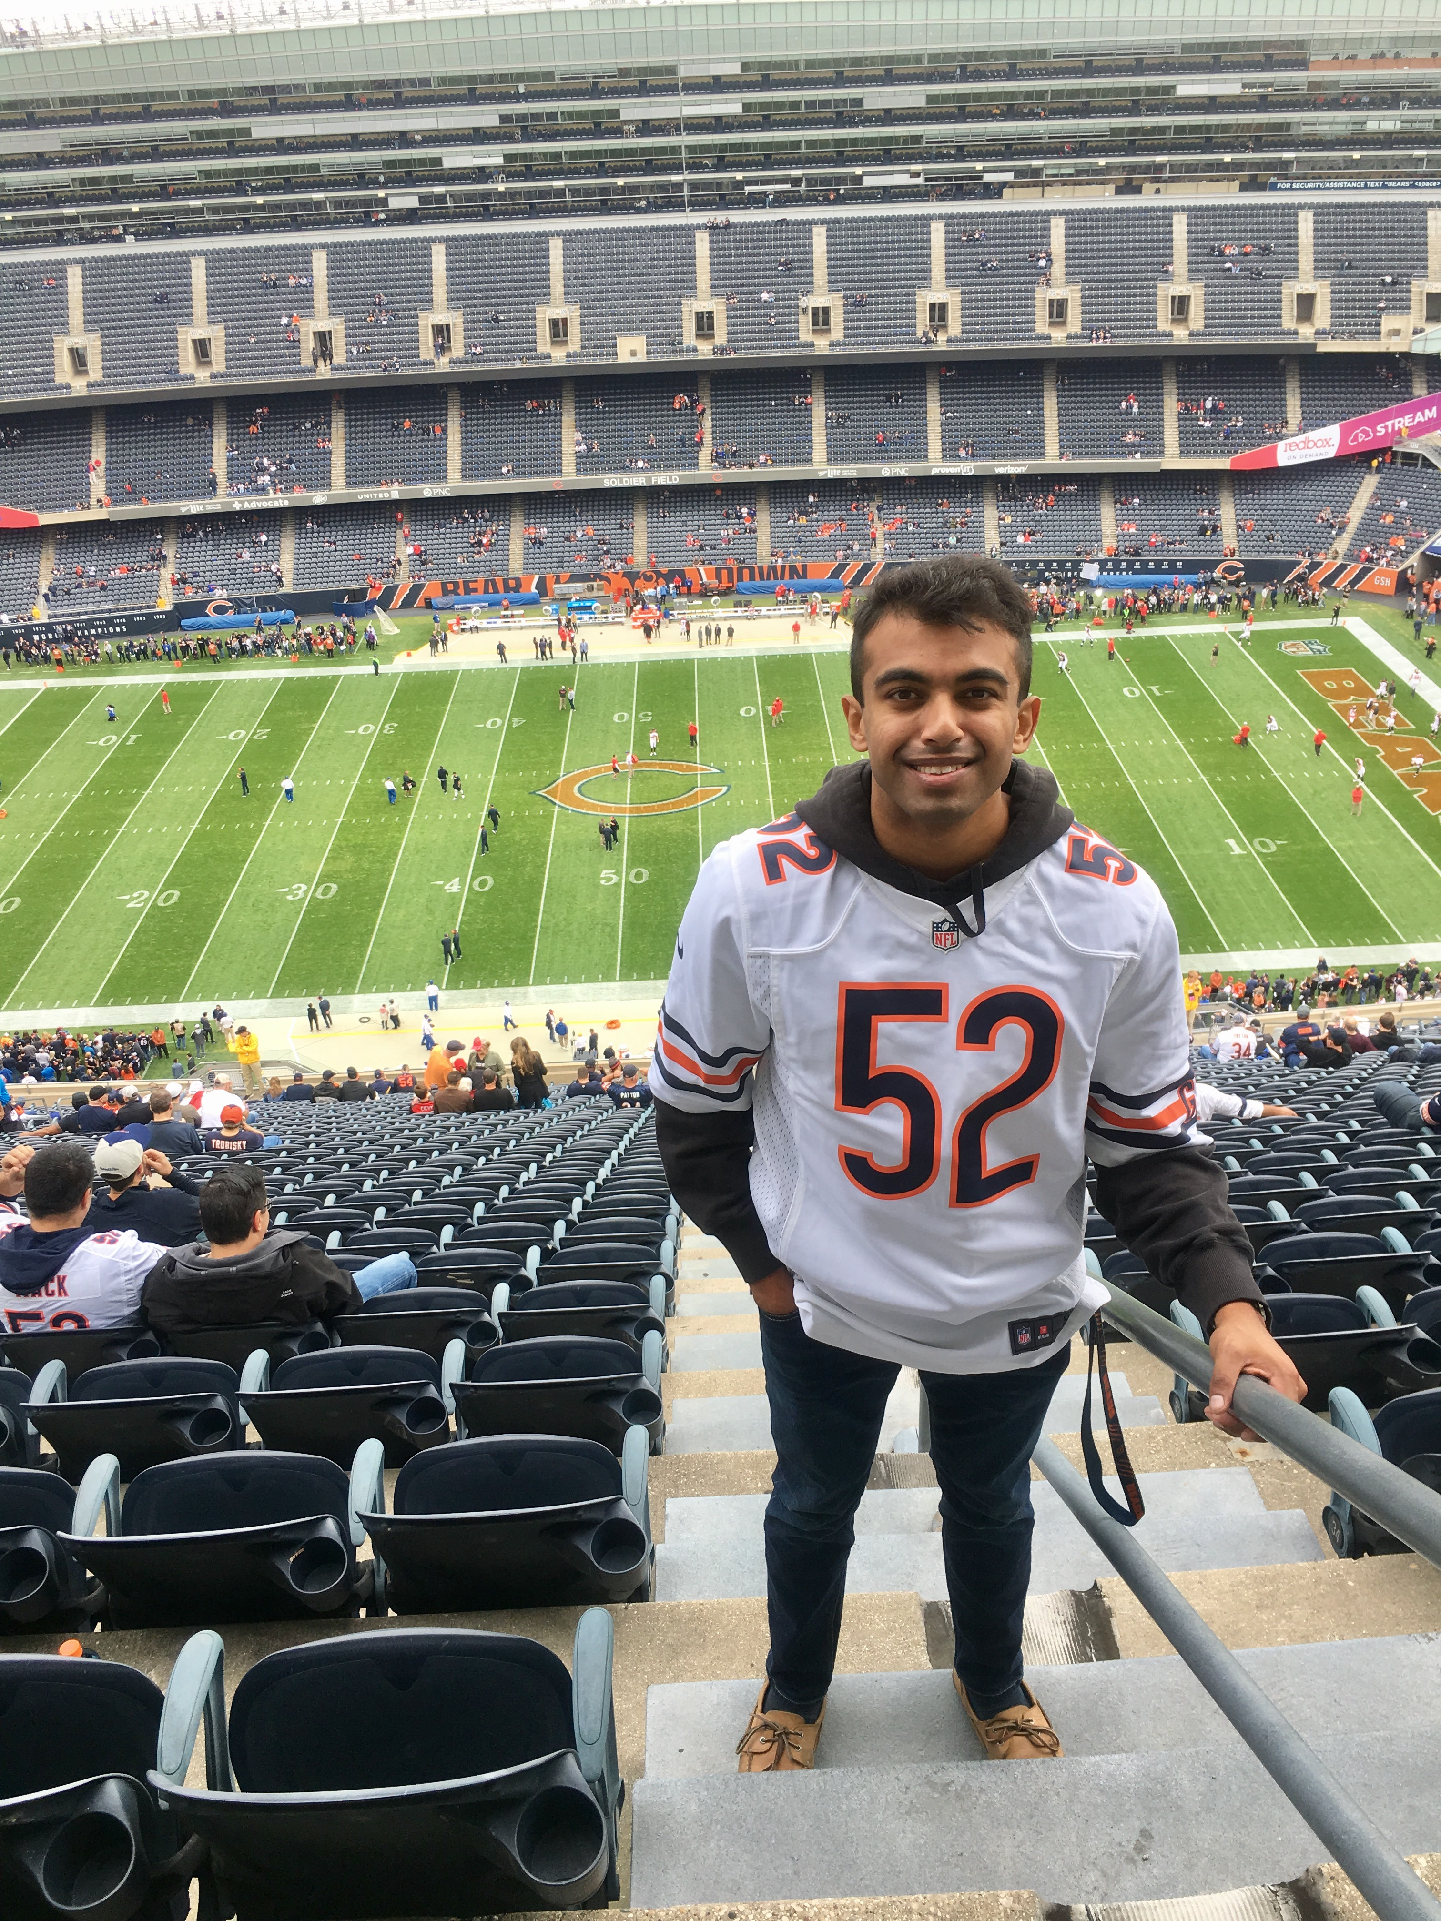

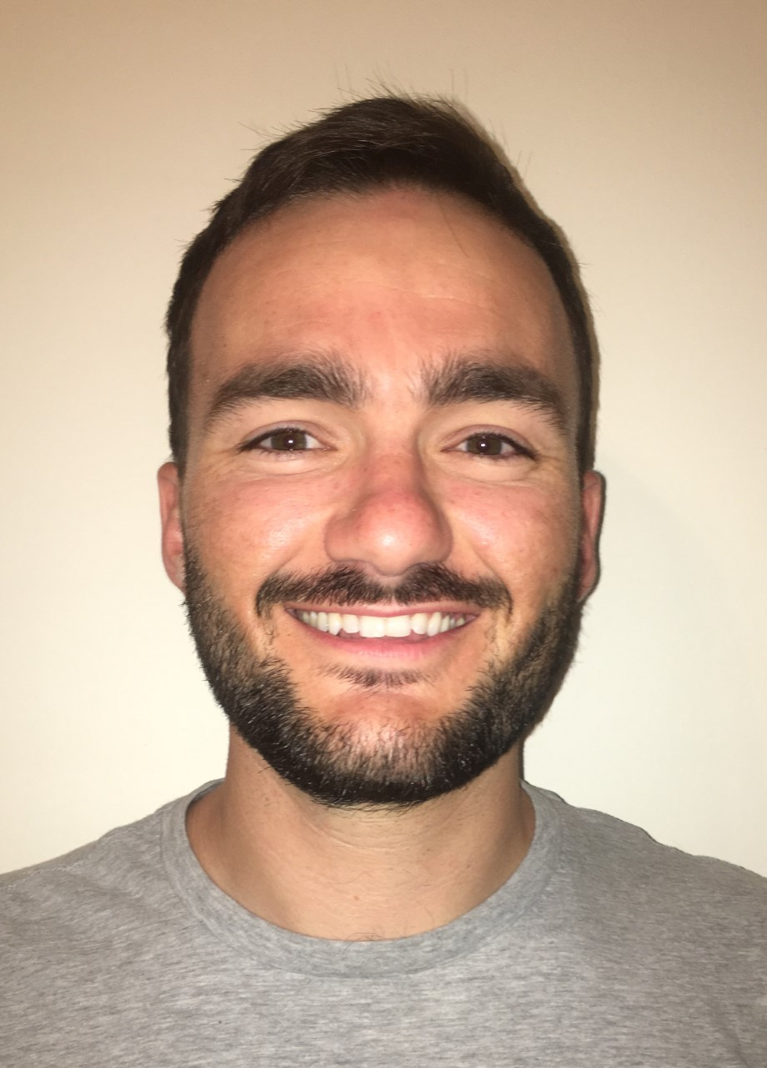

OUR TEAM
Shyan DasMadan
Formed in September 2020, CDGL Group is led by Shyan DasMadan, Brandon Carp, Sam Gunther, and Ben Le, supporting the Data Engineering Platforms class at University of Chicago.
Brandon Carp
Sam Gunther
Ben Le
BI Engineer
Data Analyst
Integration Developer
Business Analyst

